Slide 1
Human Computer Interaction
Project Title:
Assisting differently abled user to give inputs on websites using eye movement
Vinay Kirpalani PES1201800218
Nidhi Patil PES1201801277
Rakshith C PES1201801903
Rishith Bhowmick PES1201801912

Slide 2
Problem Statement
Differently abled users have various methods to use computers ranging from special keyboards or mice, voice assisted navigation or stylus as input methods
But there are scenarios wherein they are unable to perform their intended task for various reasons such as:
Inability to perfectly place the mouse pointer at the desired location.
Text not being recognised properly due the accent being different from what the device was trained on
Situations like these call for another input method which could tackle these issues
One of the sense organs that could be used is vision, i.e. eyes, which could be tracked in order to take inputs from the user

Slide 3
Need Finding
The audience in concern are mainly those who have limited motor skills such as
Lost or damaged limb
Spinal Cord Injury
Fractured arm
Missing fingers
Senior Citizens
Hospitalised Patients

Slide 4
Brainstorming
While performing the background search, we looked into the existing methods currently used to assist differently abled users and found the following:
On screen/ virtual keyboard
Braille keyboard and Braille display device
Microphones
Head-mounted pointers
Gesture-recognition devices
Magnification devices

Slide 5
Interview 1
Jungkook has worked as a reporter for more than 20 years and has developed a repetitive strain injury that makes it painful to use a mouse and to type for extended periods of time.
Though it took considerable research, time, and commitment to learn, he is able to work with less pain using the following modifications to his work environment:
use of an ergonomic keyboard
use of keyboard commands without a mouse
voice recognition software on his computer and mobile phone
assistive touch on his mobile phone
Alex encounters problems when websites and other online content cannot be navigated by keyboard commands alone. He frequently encounters web forms that do not have keyboard equivalents. Sometimes it is also difficult to skip content and navigate to sections on a webpage without using many keyboard commands, which is very tiring and limits the time he can spend working comfortably.

Slide 6
Interview 2
Jimin is an 85 year-old with reduced vision, hand-tremor, and mild memory loss; common age-related impairments for someone his age. Yun regularly browses the web reading news sites. In recent years he also started using social media to stay in touch with his family and friends. He maintains his own blog where he posts articles on art history and other topics he enjoys.
Like many older individuals, Yun has difficulty reading small text and clicking on small links and form elements. His daughter showed him how to enlarge text in the web browser, which works well on many websites. He encounters problems when text does not reflow when it is enlarged and he is forced to scroll back and forth to read the enlarged content, which means he easily loses track of his place. He also has problems with CAPTCHA images found on many social media sites. The text is so distorted, even when he enlarges it, that he often cannot accurately enter the text. He has a better experience on sites that use alternative CAPTCHA options, unfortunately only a small number currently do.

Slide 7
The solution: EasyTyper
Easy Typer is a solution that helps users by just glancing over the screen, without the aid of any external devices.
It detects the eye movements and makes a decision on the letter they are looking at and picks that said letter as input.
Eye movements are picked up by the webcam and using AI assisted eye tracking technology, helps users give inputs on websites.

Slide 8
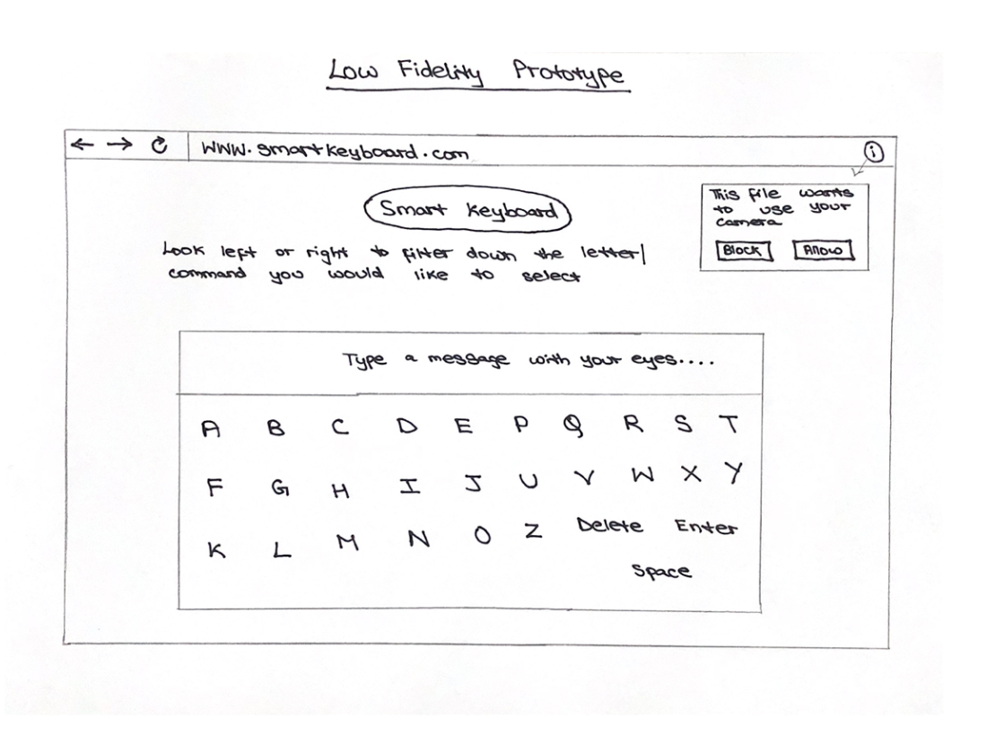
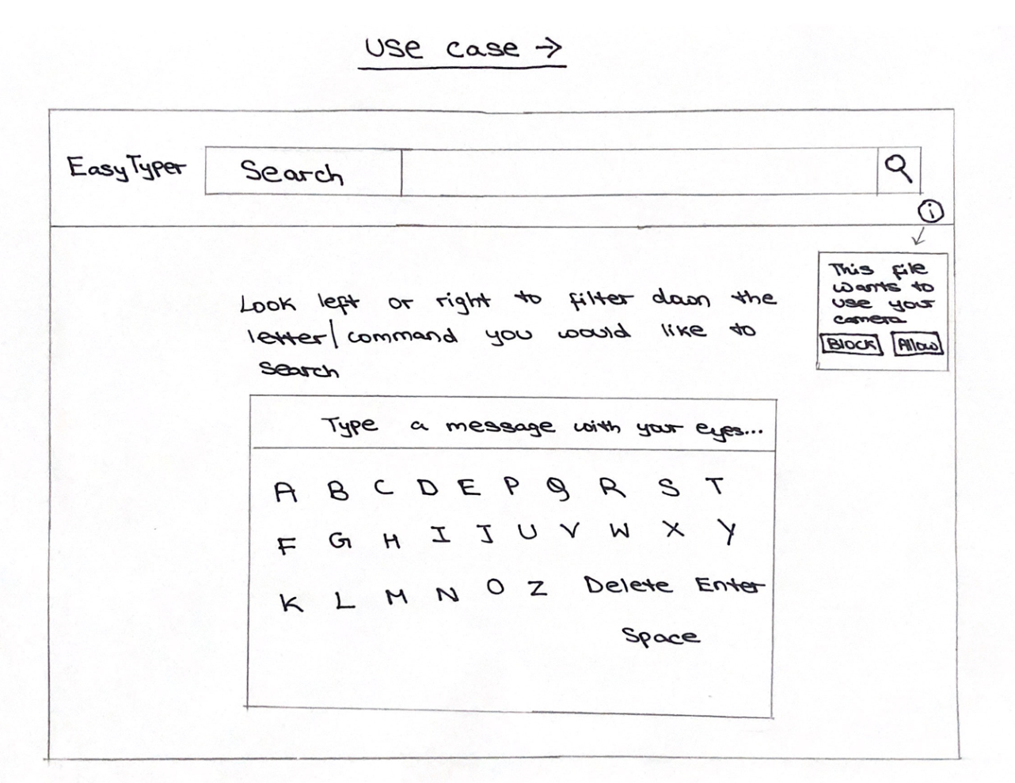
Low Fidelity Prototype
In order to create the low fidelity prototype, we have used sketching and storyboarding.

Slide 9
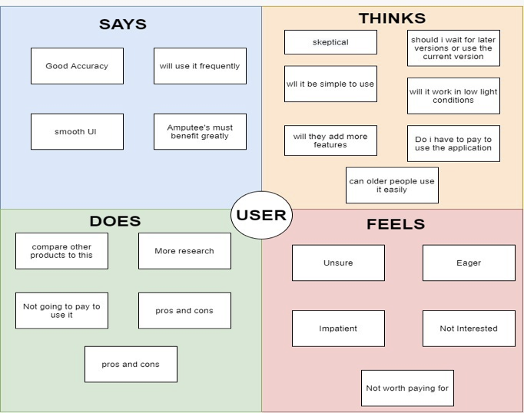
Empathy Map
A survey was conducted and feedback was collected as well along with prospective target audiences who might be interested in Easy Typer.
An Empathy Map was constructed from the responses received displaying a typical user’s perspectives after combining the four aspects obtained by analysing each user’s response.

Slide 10
Heuristic Evaluation
Strive for consistency
Consistent sequences of actions should be required in similar situations; identical terminology should be used in prompts, menus, and help screens; and consistent color, layout, capitalization, fonts, and so on, should be employed throughout. Exceptions, such as required confirmation of the delete command or no echoing of passwords, should be comprehensible and limited in number
When the web application is started a prompt on the top left hand side of the web page occurs. This prompt seeks permission for the system to switch on the web camera (If permission is granted then the web camera is switched).
The instructions section specifies how the user should go about to use the application.
The instruction section can be found above the keyboard in a text box. The current state of execution is also mentioned above the keyboard.
As and when the user looks left and right, the options of the keys on the keyboard is narrowed down consistently. During the process of options being narrowed down, the layout and color stays completely consistent.

Slide 11
Heuristic Evaluation
Seek universal usability
As the frequency of use increases, so do the user's desires to reduce the number of interactions and to increase the pace of interaction. Abbreviations, function keys, hidden commands, and macro facilities are very helpful to an expert user.
The easy type application contracts the size of the keyboard visible each time the user looks to either the left side or the right side. This practice reduces the number of interactions required to identify the letter to be typed.
The number of interactions are reduced as the number of interactions is directly proportional to the search space visible/applicable at any point of time. The practice described above reduces the search space visible at any point of time thereby reducing the number of interactions.
In order to delete a character, a separate delete character has been introduced onto the keyboard.

Slide 12
Heuristic Evaluation
Offer informative feedback
For every operator action, there should be some system feedback. For frequent and minor actions, the response can be modest, while for infrequent and major actions, the response should be more substantial
For every user action system provides feedback by narrowing down the keyboard window containing suitable alphabets. When a user visits the page, system displays the status of the model (“loaded”,”loading”).
Every time a user’s visits the page system asks for camera permissions to track the user’s eye movement.

Slide 13
Heuristic Evaluation
Design dialog to yield closure
Sequences of actions should be organized into groups with a beginning, middle, and end. The informative feedback at the completion of a group of actions gives the operators the satisfaction of accomplishment, a sense of relief, the signal to drop contingency plans and options from their minds, and an indication that the way is clear to prepare for the next group of actions.
Beginning
When user visits the page a prompt is issued to ask for camera permission and model starts loading
Middle
Model is loaded and user starts his eye movement to give inputs
End
System filters letters based on eye movement of the user to enable the user to select appropriate letter. System then outputs the letter onto the screen

Slide 14
Heuristic Evaluation
Offer simple error handling
As much as possible, design the system so the user cannot make a serious error. If an error is made, the system should be able to detect the error and offer simple, comprehensible mechanisms for handling the error.
When user blocks access to camera, an icon on top right shows that camera permission was denied.
If the user had denied permissions unknowingly then this icon helps him to understand the error caused
If the model fails to load, an error message is displayed to the user indicating that model has failed to load.
Permit easy reversal of actions
If a user wants to delete a letter, he must navigate to the delete button with controlled and guided eye moments.

Slide 15
Heuristic Evaluation
Reduce short-term memory load
The limitation of human information processing in short-term memory requires that displays be kept simple, multiple page displays be consolidated, window-motion frequency be reduced, and sufficient training time be allotted for codes, mnemonics, and sequences of actions.
The layout of Easy Typer will be simple as well as efficient. All options and access to features will be provided from a single screen. This will greatly reduce latency since there will not be any requirement of switching screens to access other features.

